Slide 1
UPPAAL-based Software-Defined Network Verification
Uliana Popesko
Lomonosov Moscow State University
2014

Slide 2
Plan
SDN
Timed automata
TCTL
Translation
UPPAAL
Experiments

Slide 3
Computer network
Switch1
Switch3
2
Switch2
1

Slide 4
Software-Defined Network
Controller
Switch1
Switch3
Switch2
1

Slide 5
Software-Defined Network
Controller
2
Switch1
Switch3
Switch2
1

Slide 6
Software-Defined Network
Controller
2
Switch1
3
Switch3
Switch2
1

Slide 7
Software-Defined Network
Controller
2
Switch1
3
Switch3
4
Switch2
1

Slide 8
SDN features
Control level is separated from communication devices
Network management is programmable
OpenFlow standart
Notes:
switches do not take any part in determinig packet routes, and the only their purpose is to switch packets with respect
to a controller's program.

Slide 9
Flow table. Rule
Field 1 | Field 2 | Field 3 | Field 4
Pattern
Timeout
Priority
Actions
output(op)
modify(h,n)
Notes:
The main point of switch management is to fill flow tables of switches with
flow entries which determine how packets should be processed. A flow entry
consists of matching field values which identify a set of packets to be processed
by the entry, an integer priority to eliminate nondeterminism in packet switching,
an integer lifetime of the entry, and a list of actions which determine how the packet should be processed. Furthermore, some statistics may be gathered by a
switch, such as the number and size of packets switched by certain entries. Packet processing made by a switch can be divided into 3 stages. First, the
switch tries to match a packet against fields of its flow entries. If no matching
entries are found, the switch performs default actions, e.g. to drop a packet, or
to send it to the contoller. If some matching entries are found, the one with the
highest priority is being picked. Second, the statistics is updated. Third, flow
entry actions are applied to the packet, e.g. output(op) | send a packet to the
port op, or modify(h,n) | set the packet header h to the value n.
The controller sets new flow entries, reacting on network events, such as
switch connection, switch removal, flow entry lifetime expiration, etc. Additionally, the controller performs active communication, sending messages to the
switches to set new flow entries in flow tables, remove all entries matching to a
certain pattern, determine unexpected packet processing, etc.

Slide 10
SDN invariants
No loop
No packet loss
OpenFlow rule consistency
Consistency with protocols

Slide 11
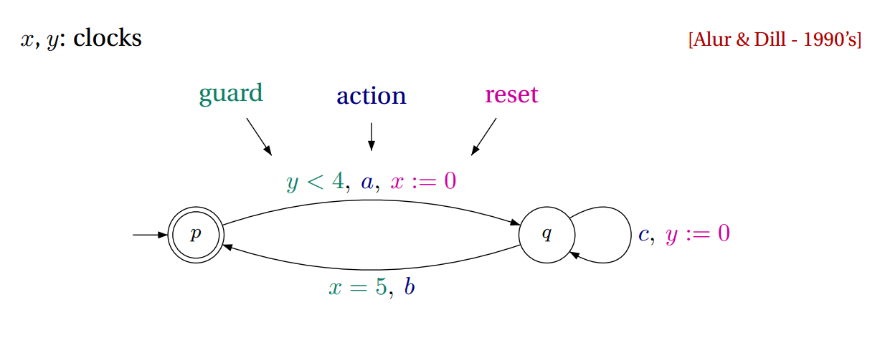
Timed Automata

Slide 12
Timed Automata. Definition
(Σ, S, S0, X, T)
Σ – a finite alphabet,
S – a finite set of states,
S0 $⊆$ S – a set of start states,
Х – a finite set of clocks,
T: S × Σ × C(X) × 2^{X} × S – gives the set of transition
Notes:
Transition from state s to state s’ on input symbol a. 2^{X –} the clocks to be reset with this transition, and C(X) is a clock constraint over X.

Slide 13
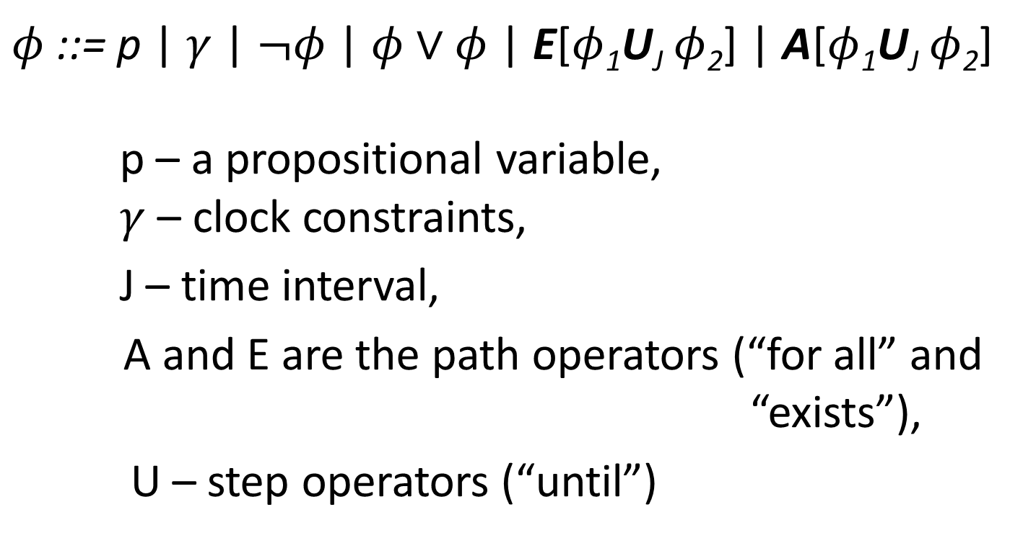
Timed Computation Tree Logic, TCTL
$φ$ ::= p | $γ$ | $¬φ$ | $φ∨φ$ | E[$φ$₁U_{J} $φ$₂] | A[$φ$₁U_{J} $φ$₂]
p – a propositional variable, $γ$ – clock constraints,
J – time interval,
A and E are the path operators (“for all” and “exists”),
U – step operators (“until”)

Slide 14

TCTL, examples
AG(request -> AF$≤10$response)
A[off U$≤15$ on]
EG[send(m) -> EF $>4$ recover(r_{m})]
Notes:
Всегда после посылки запроса ответ придёт не более чем через 10 единиц времени
Свет будет включен не более чем через 15 единиц времени
Существуют вычисления, на которых подтверждение на посланное сообщение может быть получено более чем за 4 единицы времени

Slide 15
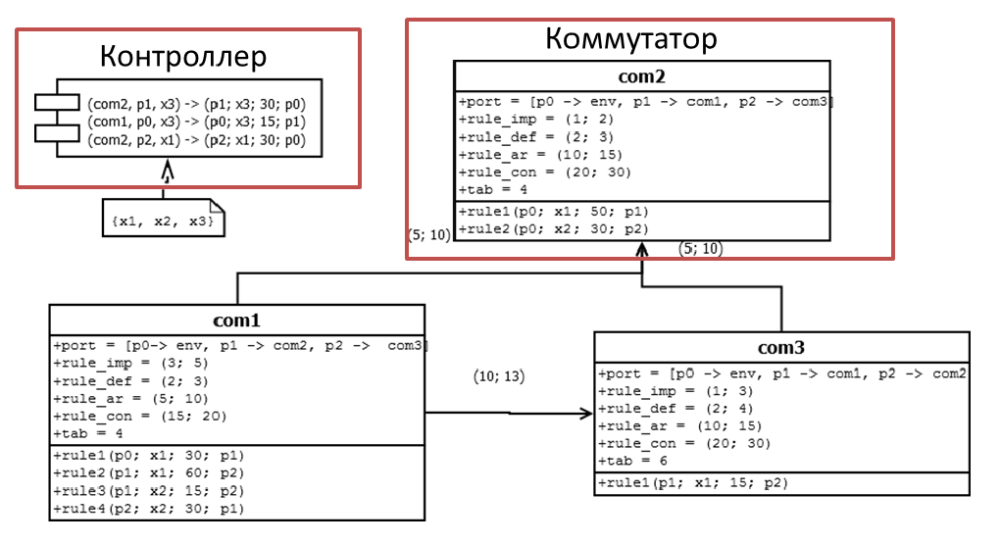
Formal model, UML diagram
Controller
Switch

Slide 16
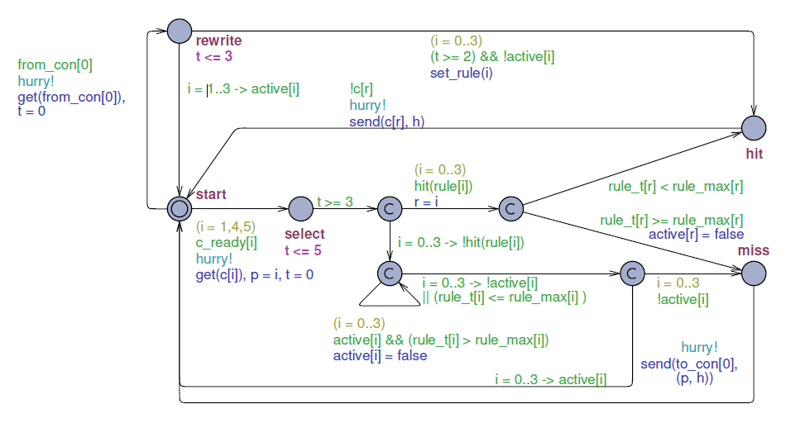
Translation algorithm
Input: UML-diagram
Output: UPPAAL network of timed automata

Slide 17
Algorithm correctness
Correct iff UPPAAL formulae are equisatisfiable for an SDN and an NTA
Formalization for SDN behavior with rewriting
Stuttering equivalence for labeled transition systems

Slide 18
Experiment
The system contains no deadlocks:
A[] not deadlock
The environment constantly generates new packets:
A <> forall(num : int[0; 2]) (channel_h[stream:align[num]])
The switch does not process any packet:
E[] com1:start
At least one packet is sent to the controller:
E <> !con:idle
The switch successfully processes at least one packet:
E <> com1:hit
 | Number of property
 | 1 | 2 | 3 | 4 | 5
2 sw, empty tables | 27 h | 1 s | 1 s | 1 s | 1 s
3 sw, ring | - | 1 s | 1 s | 7 s | 1 s
4 sw, star | - | 1 s | 1 s | 62 s | 85 s
4 sw | - | 1 s | 1 s | 60 s | 79s

Slide 19
Results
A formal description of SDNs
A translation algorithm which converts a given SDN description into an NTA
We proposed and implemented an approach to verification of software-defined networks considered as real-time systems against temporal property

